Slide 1
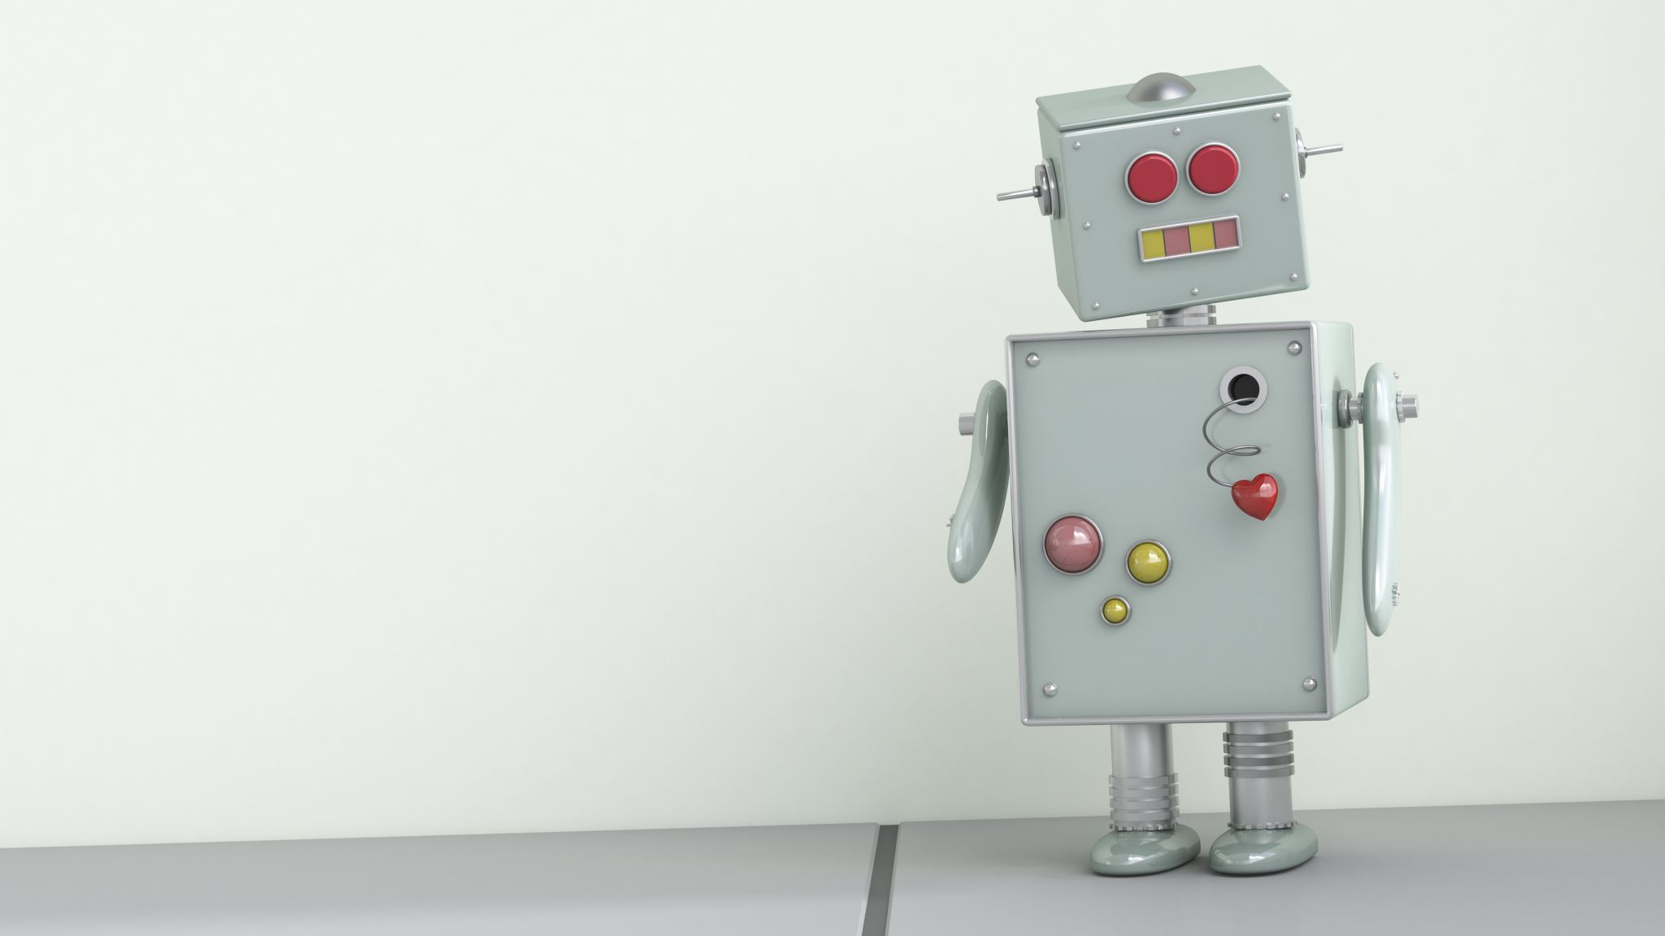
A REAL TIME DESIGN AND IMPLEMENTATION OF WALKING QUADRUPED ROBOT FOR ENVIRONMENTAL MONITORING

Slide 2

TABLE OF CONTENTS
INTRODUCTION
PROBLEM STATMENT
LITERATURE SURVEY
OBJECTIVES
SYSTEM REQUIREMENTS
METHODOLOGY
RESULT
CONCLUSION AND FUTURE SCOPE

Slide 3
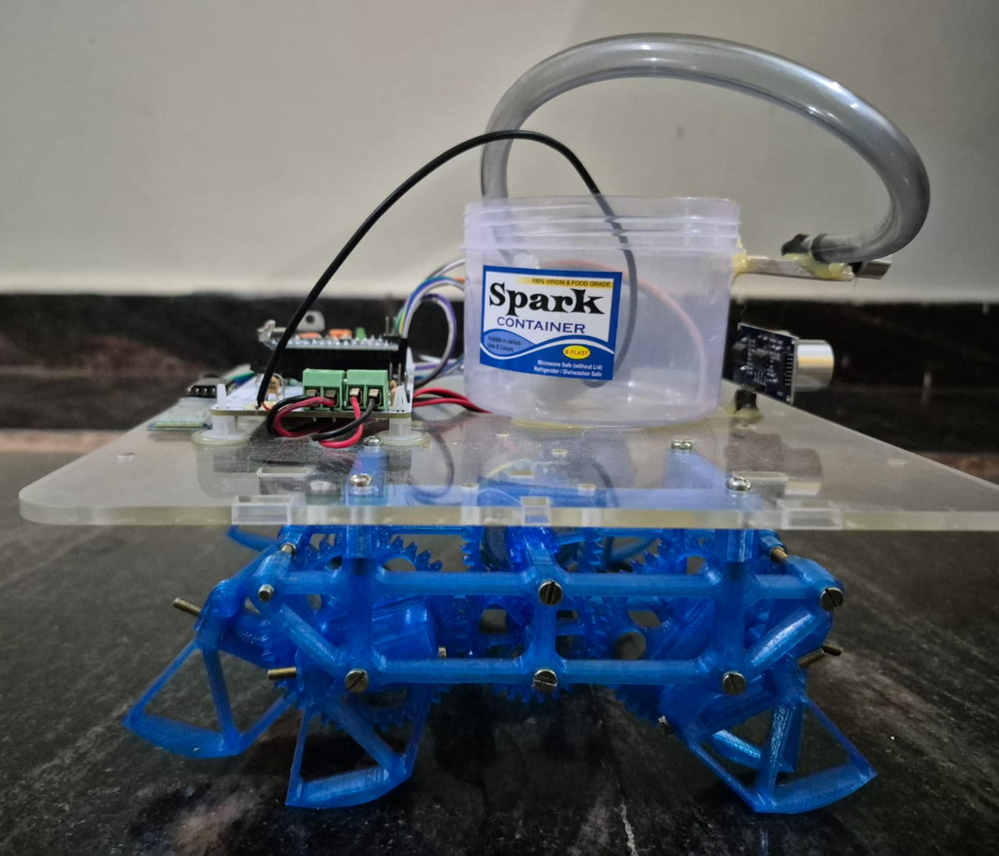
INTRODUCTION
In many cases, there is a requirement for mobile platforms that can move in areas with difficult landscape conditions where wheeled vehicles can't travel. Samples of such situations can be found in search and salvage task, and in addition in conveying payloads. Not at all like wheeled robots, walking robot are described by great portability in unpleasant territory. The primary objective of this paper is to show an inventive, modular and reasonable design of a four-legged robot for environmental research purpose. The objective is to create a cheap legged platform, which allows research and testing of walking chassis and monitoring environmental conditions. The robot should either be driven from the base station or remote location that should send all available data from sensors, which will be displayed on the computer in the user interface program. It is also important to create and program a system into the microcontroller unit (MCU) of the robot, which would have the capacity to control the servomotors and sensors.

Slide 4
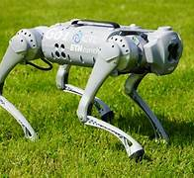
The increasing need for effective environmental monitoring has led to the development of innovative robotic solutions. One such solution is the real-time design and implementation of a walking quadruped robot, capable of navigating rough and uneven terrains where traditional wheeled or tracked robots may struggle. Inspired by four-legged animals, quadruped robots offer enhanced mobility, stability, and adaptability, making them highly suitable for outdoor environmental monitoring applications.This project focuses on the design, development, and deployment of a quadruped robot equipped with environmental sensors such as temperature, humidity, gas detectors, and cameras. The robot is designed to operate autonomously or semi-autonomously, using sensors and embedded systems to gather real-time data from remote or hazardous environments such as forests, industrial zones, or disaster-struck areas.

Slide 5
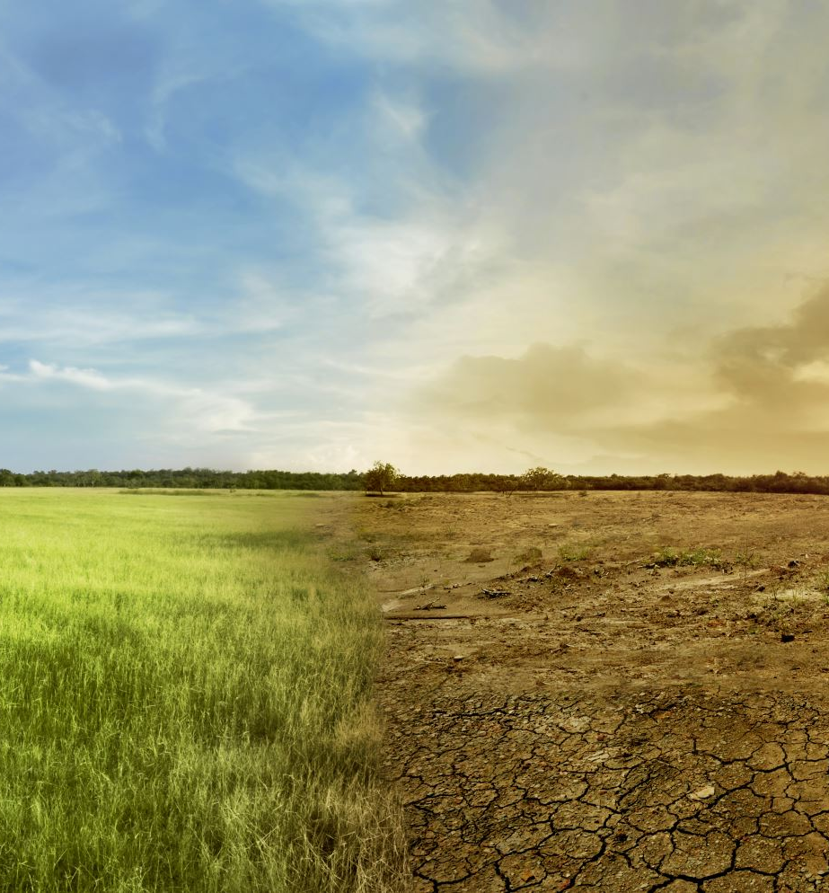
PROBLEM STATEMENT
In our project we are proposing Quadruped, to cater needs for various applications such as Agriculture application. We had proposed a solution with minimum and affordable cost. To control robot, wire-less remote controller is implemented. Monitoring environment temperature & humidity soil moisture etc. An important feature of the robot is that it has low-cost maintenance requirements and replacement of a component does not affect its performance.

Slide 6
LITERATURE SURVEY
1. Evolution of Quadruped Robotics
Quadruped robots have their roots in biologically inspired robotics, where locomotion is modeled after animals like dogs or goats for terrain adaptability.
Raibert et al. (2008), from Boston Dynamics, introduced the concept of dynamic quadruped movement with real-time stability control, laying the groundwork for future robotic designs.
Semini et al. (2011) presented HyQ, a hydraulically actuated quadruped, highlighting robust gait planning and load handling abilities.
Hutter et al. (2016) developed ANYmal, a fully autonomous quadruped robot capable of inspection in complex industrial environments using 3D vision and environmental sensors.

Slide 7
2. Real-Time Control and Locomotion Strategies
Real-time gait control, coordination, and stability maintenance are critical in field robots.
Boaventura et al. (2012) explored the use of Model Predictive Control (MPC) in real-time locomotion of legged robots, achieving adaptive walking on varying terrains.
Kalakrishnan et al. (2010) used machine learning-based locomotion to allow quadrupeds to learn optimal walking patterns based on terrain feedback.
Lee et al. (2019) developed a real-time embedded system that synchronizes multiple servos using feedback loops and inertial measurement units (IMUs) for posture control.

Slide 8
3. Environmental Monitoring Use-Cases with Robotics
Robots have already been used successfully in a wide range of environmental monitoring applications.
Sarkar et al. (2018) built a ground robot equipped with gas, temperature, and smoke sensors for post-disaster monitoring in industrial plants.
Sugiura et al. (2021) proposed a mobile robot that surveyed radioactive zones after the Fukushima disaster, reinforcing the role of autonomous systems in human-unreachable areas.
Pyo et al. (2022) implemented real-time climate monitoring robots in forested areas for early wildfire detection, using environmental thresholds to trigger alerts.

Slide 9
OBJECTIVES
1. Design and Construct a Quadruped Robot : Develop a four-legged robotic platform capable of stable and adaptive walking on varied terrain using appropriate actuators, sensors, and structural materials.
2. Implement Real-Time Locomotion Control : Design and implement a real-time control algorithm (e.g., inverse kinematics and gait planning) to enable smooth and responsive walking motion.
3. Integrate Environmental Monitoring Sensors : Equip the robot with environmental sensors (e.g., temperature, humidity, gas, air quality, or camera modules) to collect real-time environmental data.
4. Develop a Data Acquisition and Transmission System : Implement a system to acquire, process, and wirelessly transmit sensor data to a remote station for analysis and visualization.
5. Enable Autonomous Navigation and Obstacle Avoidance : Integrate GPS and proximity sensors (e.g., ultrasonic, LiDAR) to enable semi-autonomous or fully autonomous navigation and obstacle detection.
6. Ensure Energy Efficiency and Mobility :Optimize the power system to support long-duration operation and design the locomotion to minimize energy consumption while maintaining mobility.
7. Test and Validate in Real-World Environments : Evaluate the robot's performance in outdoor or indoor environments to ensure robustness, adaptability, and sensor accurancy.

Slide 10
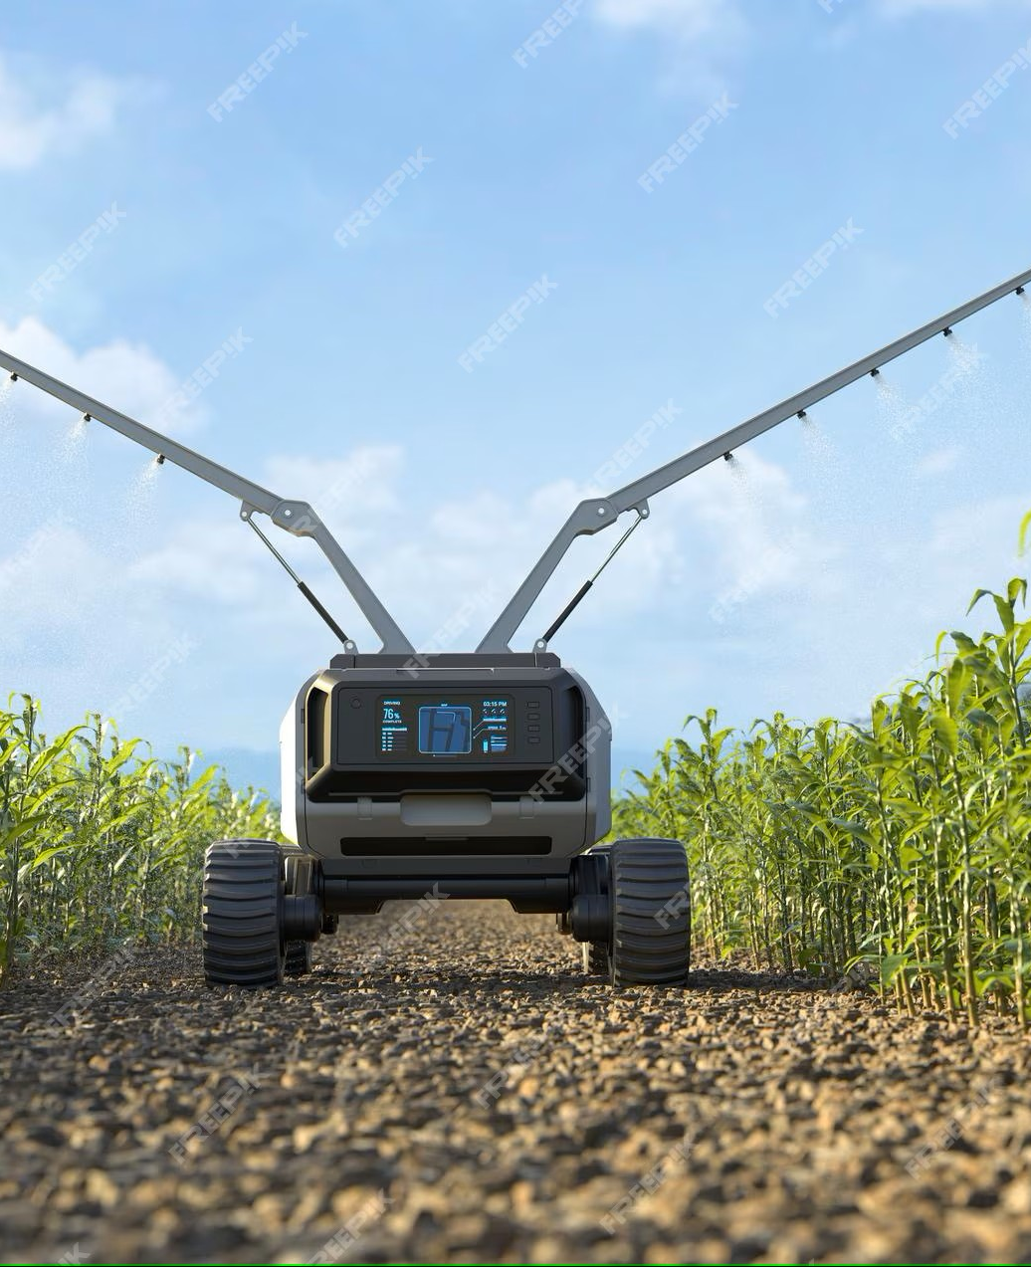
MOTIVATION
1. Terrain Adaptability: Quadruped robots are more capable of navigating rough, uneven, or hazardous terrain than wheeled or tracked robots. This makes them ideal for environmental monitoring in forests, mountains, disaster zones, or remote locations.
2. Real-Time Data Collection: Real-time design allows the robot to collect, process, and respond to environmental data instantly, which is critical for applications like detecting pollution, temperature anomalies, gas leaks, or structural instabilities.
3. Autonomous and Continuous Monitoring: A mobile quadruped robot can operate autonomously for long periods, enabling continuous and consistent environmental monitoring without human intervention.
4.Versatility in Sensors: The robot can be equipped with a variety of sensors—such as cameras, gas sensors, temperature/humidity sensors, and LiDAR—to gather comprehensive environmental data.
5.Disaster Response and Risk Reduction: In post-disaster scenarios or hazardous zones (e.g., after a chemical spill or earthquake), a quadruped robot can enter areas unsafe for humans to assess conditions and help coordinate emergency responses.
6.Advancement in Robotics Research: Designing such a robot contributes to on going research in locomotion, balance, autonomous navigation, and sensor integration in robotics.

Slide 11
Navigate rugged and unstructured terrain with better stability and flexibility.
Adapt their walking gait based on surface conditions (sand, mud, stones, vegetation).
Access hard-to-reach or dangerous areas that may be inaccessible to humans or wheeled robots.
Equipping this quadruped robot with environmental sensors (for temperature, gas, humidity, camera, etc.) and IoT communication modules can turn it into a mobile environmental monitoring station. Such a robot could autonomously collect critical environmental data and relay it in real time to a command center, aiding in:
Early warning systems (for gas leaks, fires, or air pollution),
Remote data collection in forest or mountain ecosystems,
Post-disaster reconnaissance in collapsed buildings or flooded zones,
Smart agriculture and climate-sensitive farming,
Research and conservation in inaccessible biodiversity hotspots.

Slide 12
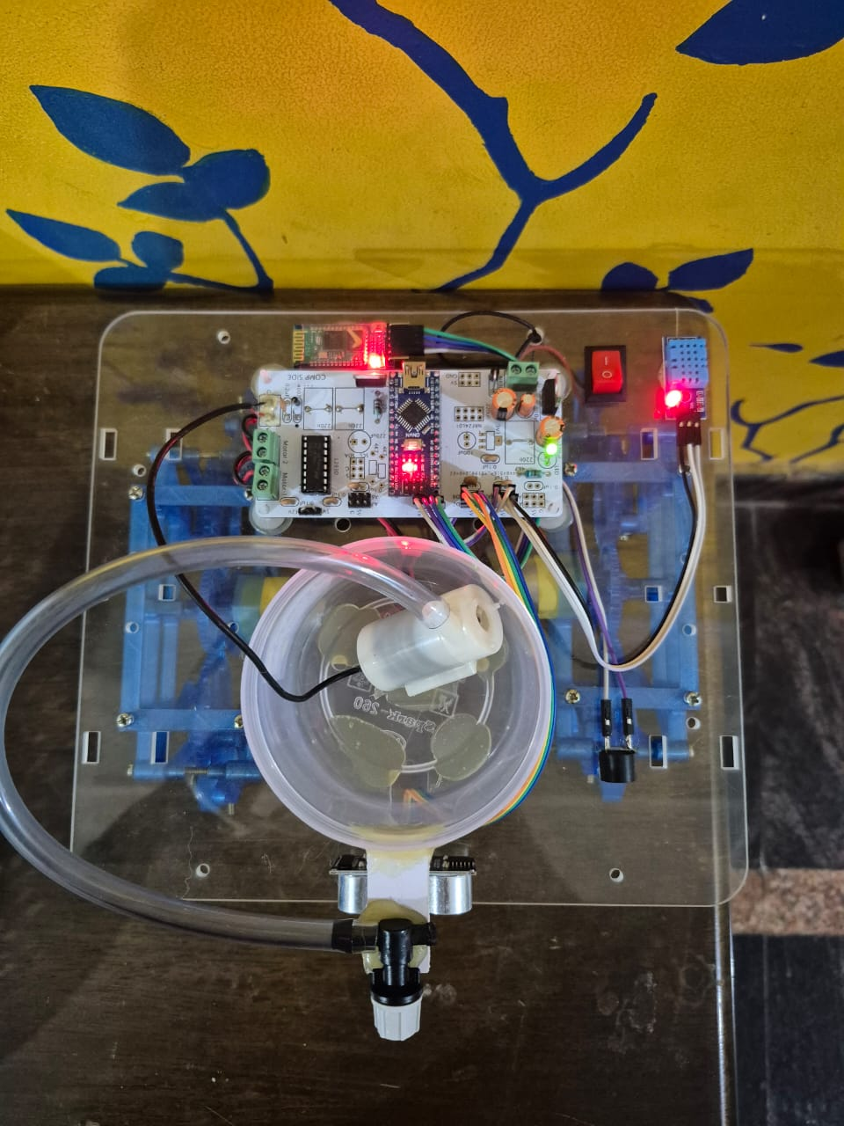
OVERVIEW OF A REAL TIME DESIGN AND IMPLEMENTATION OF WALKING QUADRUPED ROBOT FOR ENVIRONMENTAL MONITORING
Environmental monitoring is vital for assessing ecosystem health, detecting hazardous conditions, and supporting scientific research. Traditional monitoring methods often rely on stationary sensors or human intervention, which can be limited in coverage and efficiency. This project aims to design and implement a real-time, walking quadruped robot capable of navigating various terrains and collecting environmental data autonomously. The quadruped design offers enhanced mobility and stability compared to wheeled robots, making it suitable for rugged or uneven environments such as forests, construction sites, or disaster zones. The robot is equipped with multiple sensors to monitor parameters like temperature, humidity, air quality, and gas concentration. A microcontroller or onboard processor handles real-time control of locomotion, sensor data processing, and wireless data transmission. Advanced gait algorithms ensure adaptive walking patterns, allowing the robot to navigate obstacles and maintain balance. Additionally, features like GPS, obstacle detection, and wireless communication enable semi-autonomous operation and remote supervision. This project combines elements of robotics, embedded systems, sensor networks, and environmental science, offering a flexible and scalable solution for automated environmental monitoring in real time.In recent years, the demand for advanced environmental monitoring systems has significantly increased due to the global rise in climate instability, pollution levels, natural disasters, and industrial hazards. Traditional methods—such as manual inspections, fixed sensor installations, or wheeled robotic platforms—are often inadequate in accessing remote, rough, or dangerous environments. These limitations pose serious challenges to collecting real-time environmental data needed for critical decision-making in areas like disaster management, agriculture, urban safety, and conservation.To address these challenges, this project proposes the real-time design and implementation of a walking quadruped robot, which is a mobile robotic platform equipped with legs (four limbs) for walking and navigating through a wide variety of terrains. Inspired by the natural locomotion of animals, a quadruped robot provides superior stability, balance, and adaptability, especially in unpredictable outdoor environments where wheeled robots may fail.

Slide 13
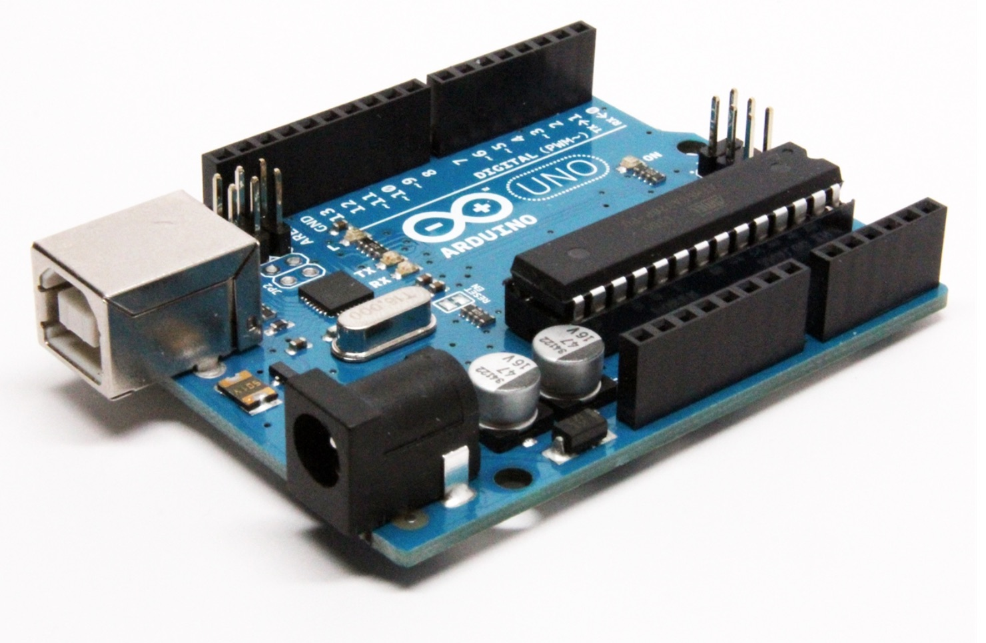
Mechanical Design The robot is designed with four articulated legs, each with multiple degrees of freedom, allowing it to mimic biological walking gaits. Materials used are lightweight and durable to ensure energy efficiency and robustness.
Locomotion and Real-Time Control The robot uses servo or brushless motors controlled via microcontrollers (e.g., Arduino or STM32) and real-time algorithms to manage balance, step size, and gait switching. Feedback systems such as gyroscopes and IMUs (Inertial Measurement Units) help maintain posture and detect terrain changes.
Sensor Integration for Environmental Monitoring The robot is equipped with a wide range of sensors, including:
Gas sensors (e.g., MQ-series) for detecting hazardous gases.
Temperature and humidity sensors (e.g., DHT11/22) for climate data.
Soil moisture sensors for agricultural insights.
Camera and LIDAR for obstacle detection and terrain mapping.
Real-Time Data Processing and Communication Data collected from the sensors is processed on-board using a Raspberry Pi or other edge computing units. The robot communicates this data in real-time to a central monitoring station using wireless technologies like Wi-Fi, Bluetooth, or LoRaWAN, depending on the range and bandwidth requirements.
Power System A battery pack powers the robot, and power management is optimized to ensure extended field operation. Solar recharging may also be integrated for sustainable use in outdoor deployments.

Slide 14
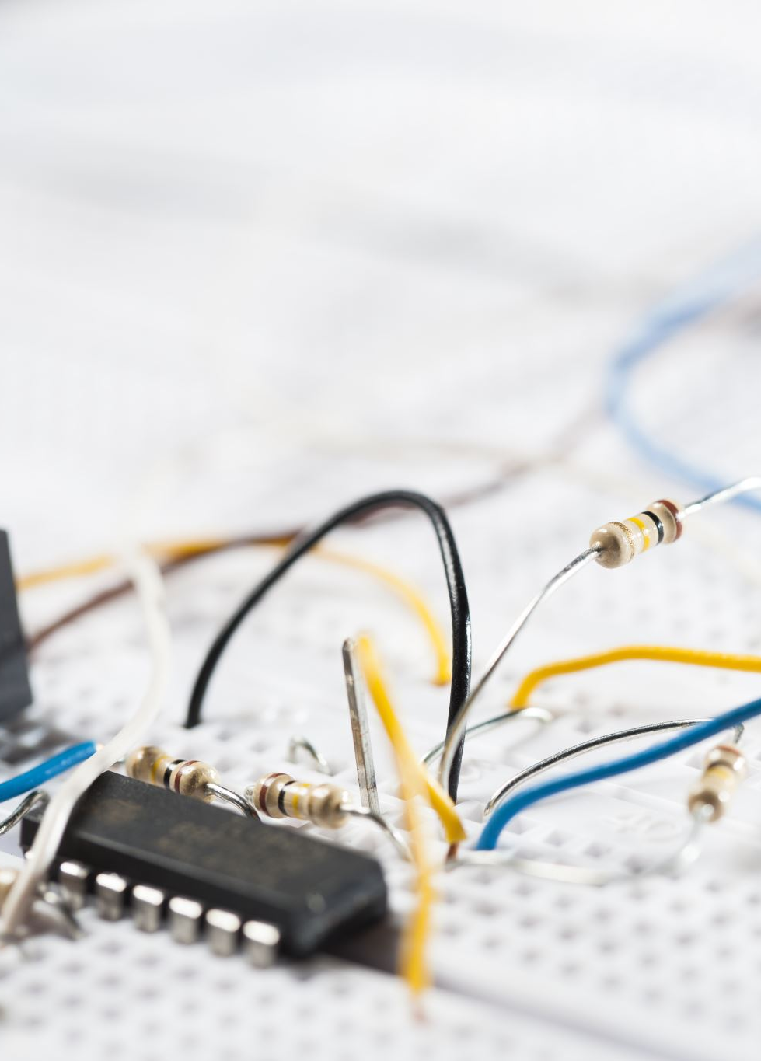
SYSTEM REQUIREMENTS
HARDWARE REQUIREMENTS:
Arduino Nano (Microcontroller Unit)
Buzzer
Sensors
Servo Motors
L293D Motor Driver IC
Ultrasonic Sensor – (HC SR04)
Transistor – (1A)
Pump
Regulator
Power Supply (Battery 11.1v)

Slide 15
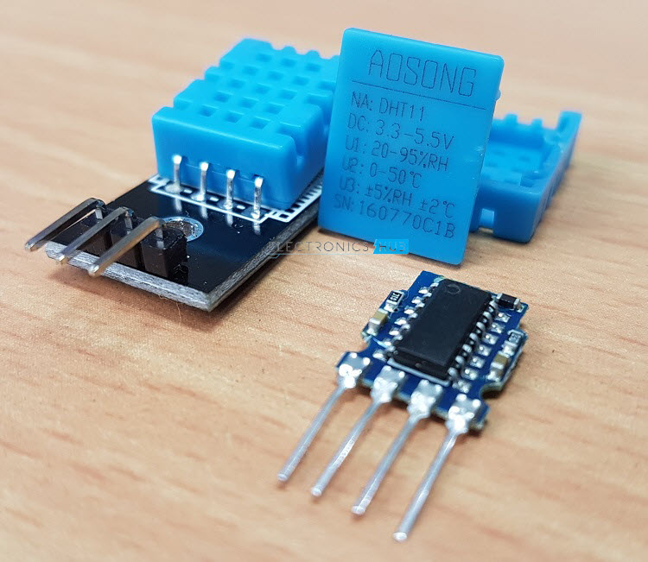
SOFTWARE REQUIREMENTS:
Operating System: Windows 10.
Programming: Arduino

Slide 16
Snapshot:

Slide 17
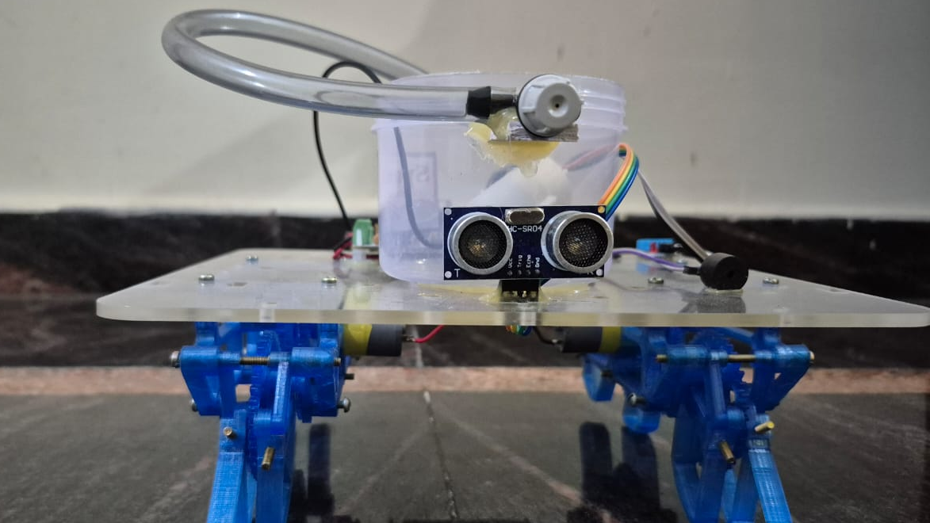

Slide 18
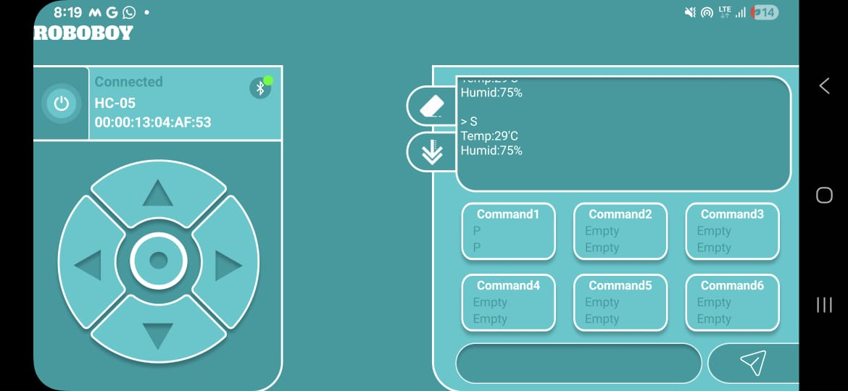

Slide 19
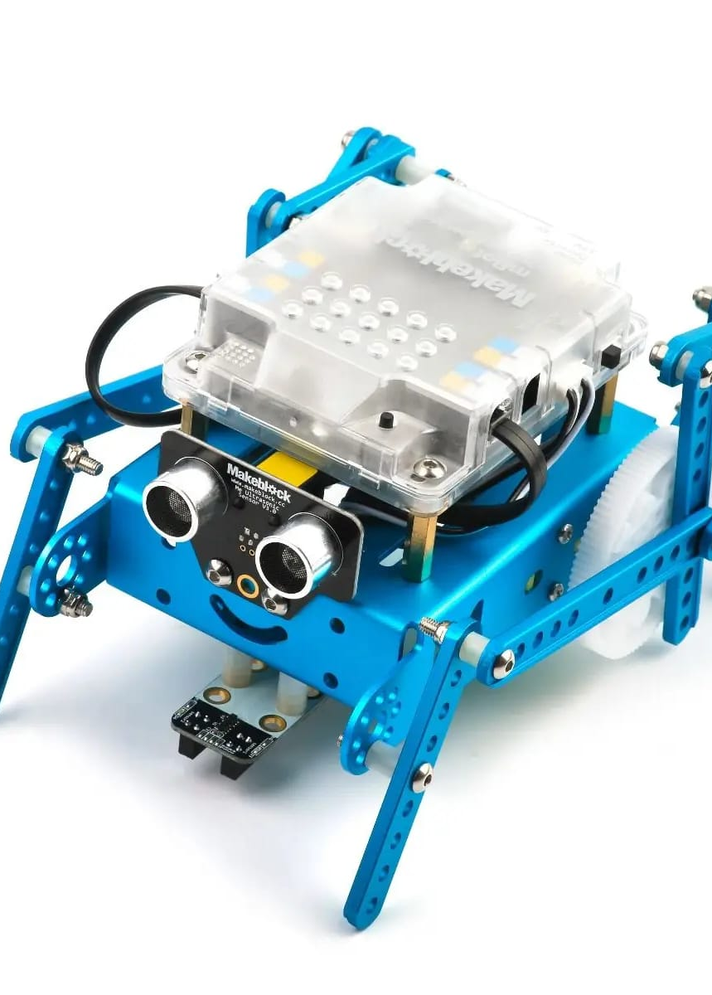
Conclusion
Comprehensively, four legged robots use articulated limbs such as leg mechanisms, to provide locomotion. They are more versatile than wheeled robots and can traverse many different terrains, though these advantages require increased complexity and power consumption. This four-legged robot is an affordable solution for many applications. An important feature is that it has low-cost maintenance requirements and replacement of a component doesn’t affect its performance. It has extensive applications compared to wheeled robots, ranging from military to industrial applications. Four legged robots have the advantage of being statically stable when not moving, but require dynamic walking control. There are many different ways for a four-legged robot to walk including alternating pairs and opposite pairs as in six legged robots. However, these techniques now cease to be statically stable and thus require dynamic control.

Slide 20
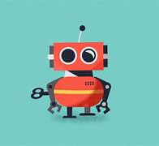
THANK YOU

